Slide 1
Numeric Ninjutsu
By:
Chirag Chandrashekar
Abhishek Limaye

Slide 2
Index
About the game
Quality checks
Game flow
Example
Constraint Satisfaction Problem
Backtracking the game flow
Result

Slide 3
About the game
Numeric Ninjutsu is a code-breaking game in which players aim to deduce a secret sequence of numbers by making guesses and receiving feedback in the form of hits (correct digits in the correct position) and strikes (correct digits in the wrong position).

Slide 4
Quality Checks
Four-digit numbers cannot start with 0 at the beginning.
Repetition of numbers is not permitted.
Hits and strike sum cannot be greater than 4.

Slide 5
Game flow
Guess
Secret Number
Player
Game Master
Hits
Strikes
Player
Guess
Hits
Strikes
Game Master
Secret Number

Slide 6
Example
Secret Number: 4862
Your guess: 1234
Hits: 0, Strike: 2
Your guess: 3125
Hits: 0, Strike: 1
Your guess: 4612
Hits: 2, Strike: 1
Your guess: 4761
Hits: 2, Strike: 0
Your guess: 4268
Hits: 2, Strike: 2
Answer is 4862
Your guess: 4862
Hits: 4, Strike: 0

Slide 7
How to tackle the problem of solving it

Slide 8
Constraint Satisfaction Problem
Consists of two things,
1. Variables representing the position of the secret code.
2. Domain consists of the possible combination of digits for each position.

Slide 9
Quality Checks
Four-digit numbers cannot start with 0 at the beginning.
Repetition of numbers is not permitted.
Hits and strike sum cannot be greater than 4.

Slide 10
Backtracking the game flow
Game Solver
Random Number
Secret Number
Player
Hits
Strikes
Game Solver
Random Number
Hits
Strikes
Player
Secret Number

Slide 11
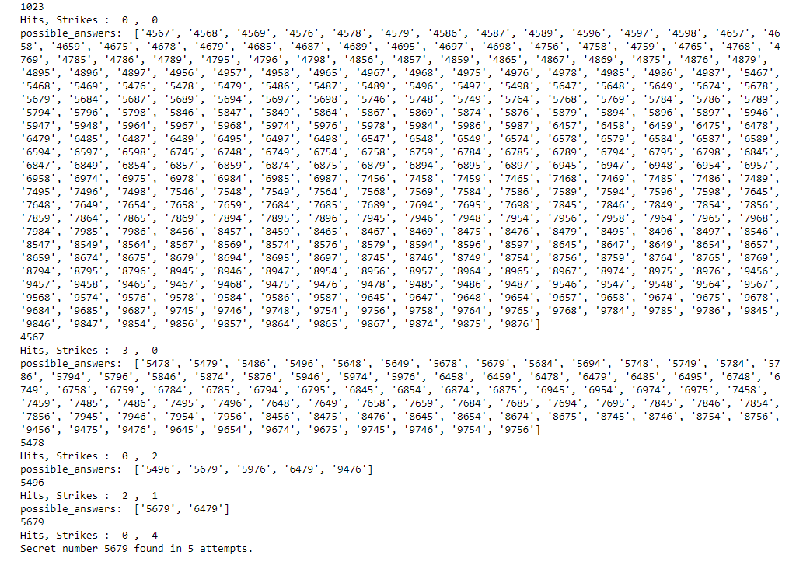
Results

Slide 12
Thankyou

